Slide 1















CL&NLP Project
Fake News Detection
Presented by:
PresentedTo:-
Nihar
DR. Achala Shakya

Slide 2


CONTENT
Introduction​
Technical Concepts
Model Architecture
Methodology​
Working Module​
Results​
Conclusion​

Slide 3
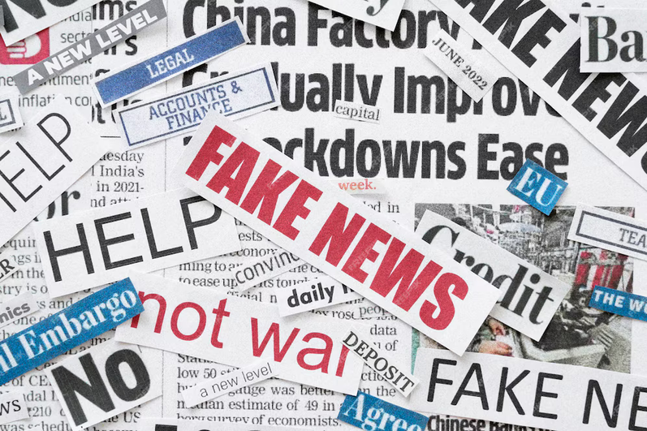
Introduction
Fake news has become a widespread issue in today's digital age, spreading misinformation and influencing public opinion.
Detecting fake news is crucial to maintaining the integrity of information and protecting democracy.
This project will outline the challenges of fake news detection and propose a machine learning approach to address them.

Slide 4
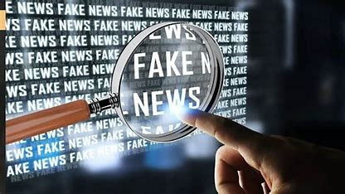
What is Fake News?
Fake news refers to false or misleading information presented as genuine news.
Examples include fabricated stories, misinformation, and traditional and digital media propaganda.
The impact of fake news can be significant, leading to public confusion, mistrust, and manipulation of public opinion.

Slide 5
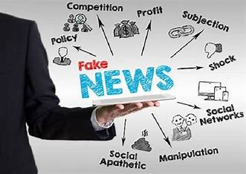
Why is it DANGEROUS?
Fake news can distort public perception and affect election results.
It can encourage violence and harm individuals or groups targeted by false information.
The widespread dissemination of fake news undermines the credibility of legitimate journalism and institutions.

Slide 6
Technical Concepts:-
1) NLP:- Cleaning of Text(removal of Special Characters and emoji from dataset and apply lemmatizer).
2) Sentiment Analysis Using Text Blob.
3) TF-IDF
4) Machine Learning:- Logistic Regression

Slide 7
MODEL ARCHITECTURE

Slide 8
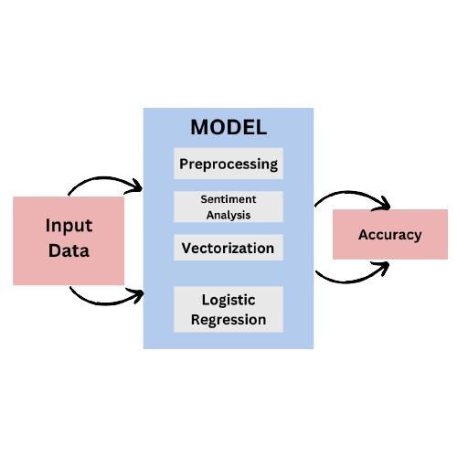

Slide 9
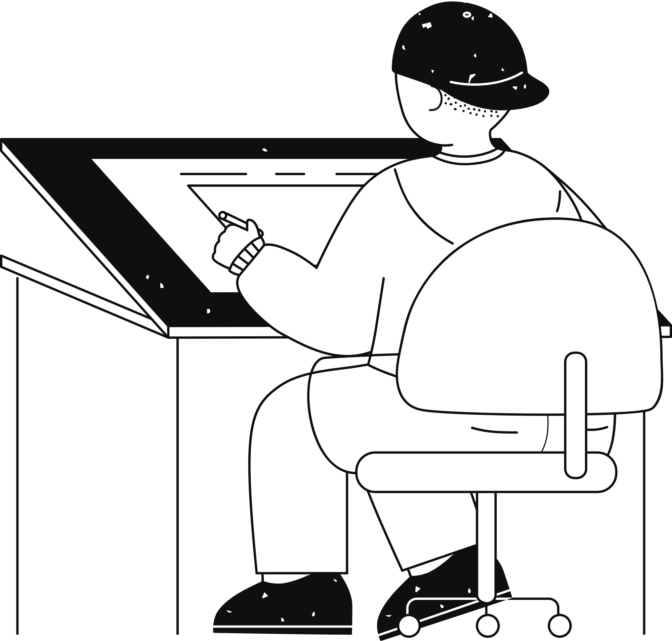
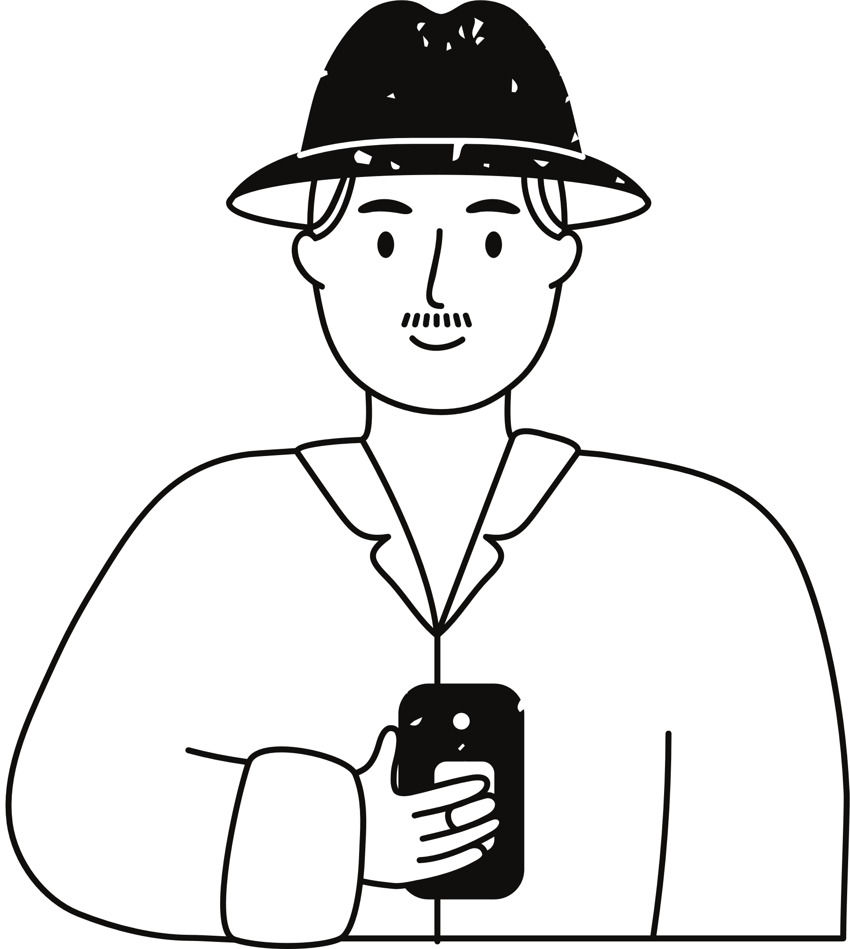




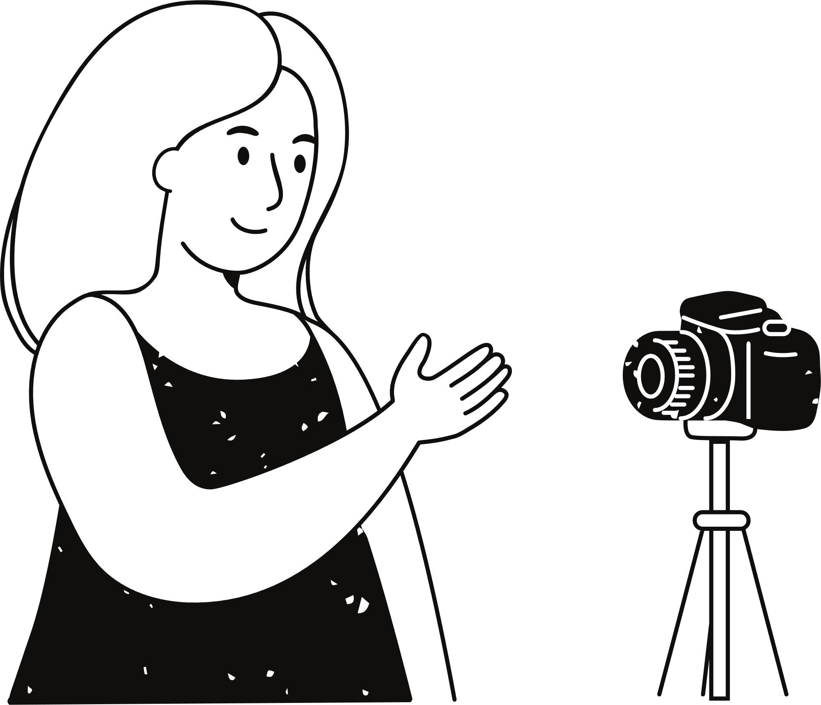
DATA COLLECTION
TEXT-VECTARIZATION
PREPROCESSING
Methedology
MODEL IMPLEMENTATION
Mind
Map
SENTIMENT ANALYSIS
PREDICTION

Slide 10
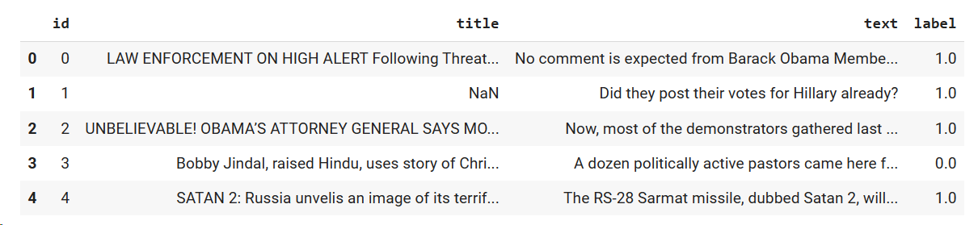
DATASET

Slide 11
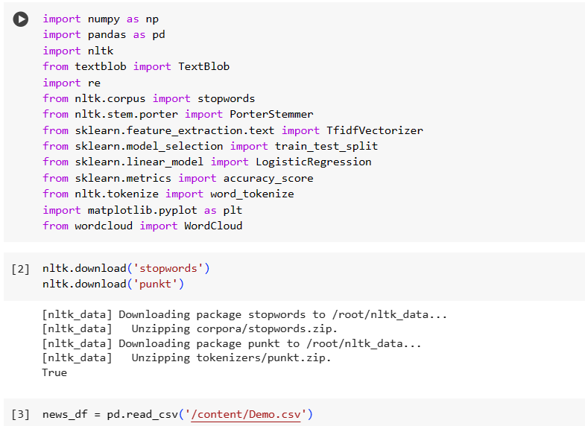
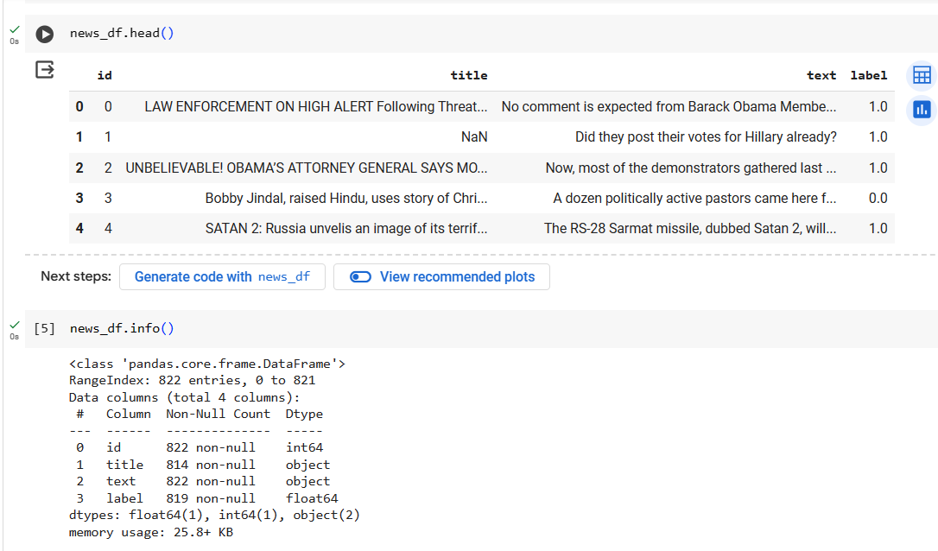
WORKING MODULE

Slide 12
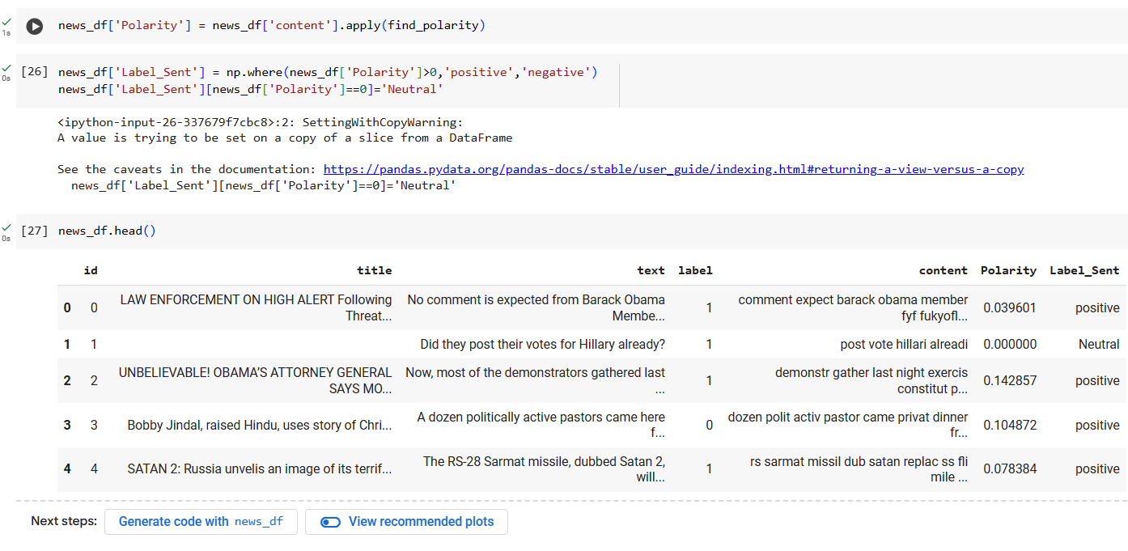
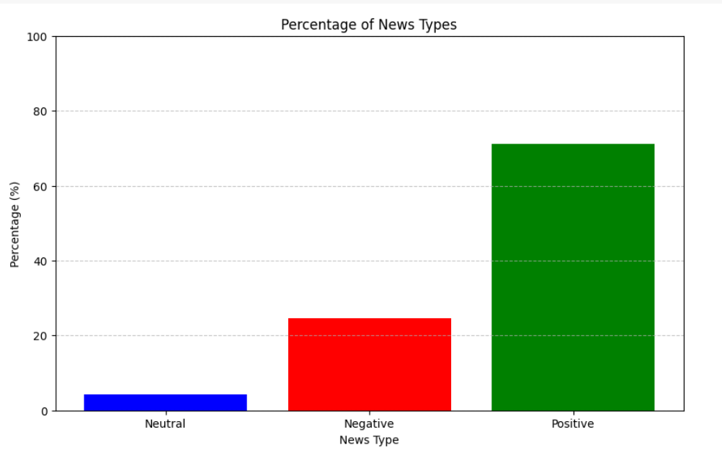
WORKING MODULE

Slide 13
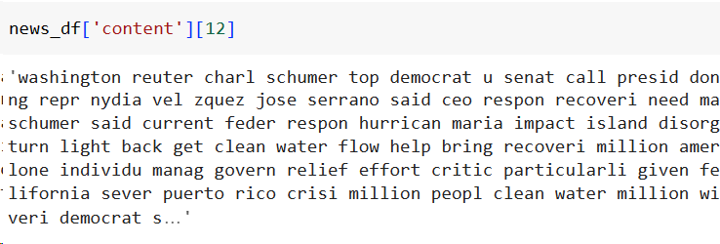
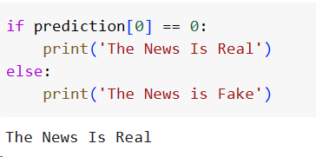
RESULTS

Slide 14
CONCLUSION
In Conclusion, our fake news detection method combines logistic regression, sentiment analysis, and TF-IDF vectorization. This approach helps identify fake news articles and encourages media literacy. As we all know fake news is hazardous for democratic country as it can influence any community badly, which can result in big conflicts.

Slide 15

Thank you

